Slide 1

USACO Bronze Week 2/3

Slide 2

Content of Today’s class
Review Week 2 Homework
Basic string operations
PythonChallenge-maybe??
Brute force/Strategic brute force

Slide 3
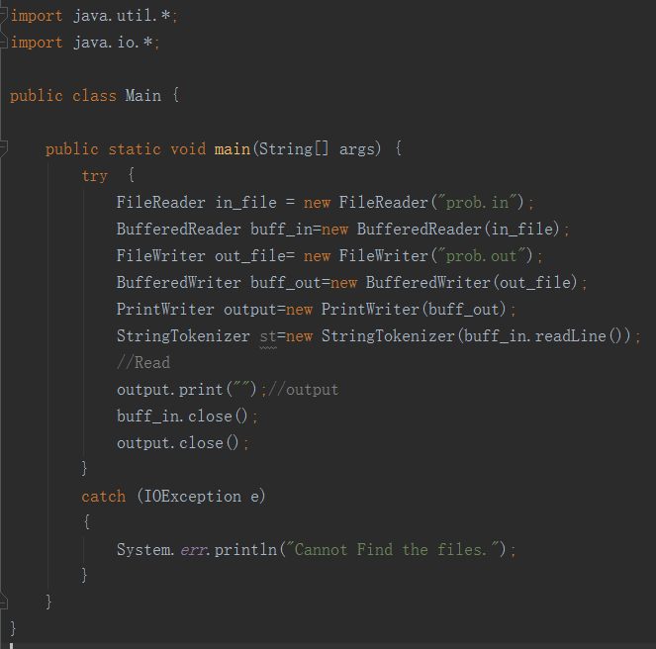
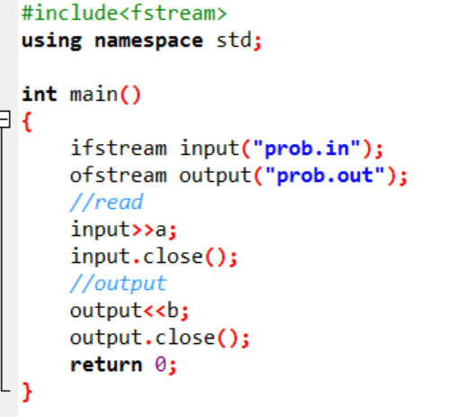
File Input And Output -review
Java
C++

Slide 4
File Input And Output - Review
Exercise:
Write a program which read data from atimesb.in and output the data to atimesb.out, and do the following calculation:
First read two integers a and b, and then calculate a*b. Output the answer as an integer into the file.

Slide 5
String Operations
Operation/Complexity | C++ | Java
Create a string. O(N) | string str = “Hello World”; | String str = “Hello World”;
Append one string to another string’s end. O(N) | str += another; //--OR-- str.append(another); | str = str.concat(another);
Get length of the string. O(1) | int a = str.size(); | int a = str.length();
Get specific character at index. O(1) | char c = str[index]; | char c = str.charAt(index);
Get substring. O(N) - N is number of characters | //[startpos, startpos+length-1] str.substr(startpos, length); | str.substring(startpos); //[startpos, end] str.substring(startpos,endpos); //[startpos, endpos) (exclusive)
Check if the string starts with something. O(N) - N is the length of query string | N/A | boolean starts = str.startsWith(something);
Find the index of something. O(N) - N is up to length of original string | size_t id = str.find(word); //returns string::npos if not found | int id = str.indexOf(word); //index of 1st occurance; -1 if none! boolean exists = str.contains(word); // True if the string contains the word requested

Slide 6
String Operations
Bessie and her cow friends are playing as their favorite cow superheroes. Of course, everyone knows that any self-respecting superhero needs a signal to call them to action. Bessie has drawn a special signal on a sheet of M×N paper (1≤M≤10,1≤N≤10), but this is too small, much too small! Bessie wants to amplify the signal so it is exactly K times bigger (1≤K≤10) in each direction.
The signal will consist only of the '.' and 'X' characters.
http://www.usaco.org/index.php?page=viewproblem2&cpid=665
Solution: https://docs.google.com/document/d/11yzOdnTxGrtoYL5LPtNx-5nSBsqTvlAnnCwolj6lE6k/edit (don’t look until you’ve tried at least once)
https://repl.it/repls/PerfumedKnottyLibrary

Slide 7
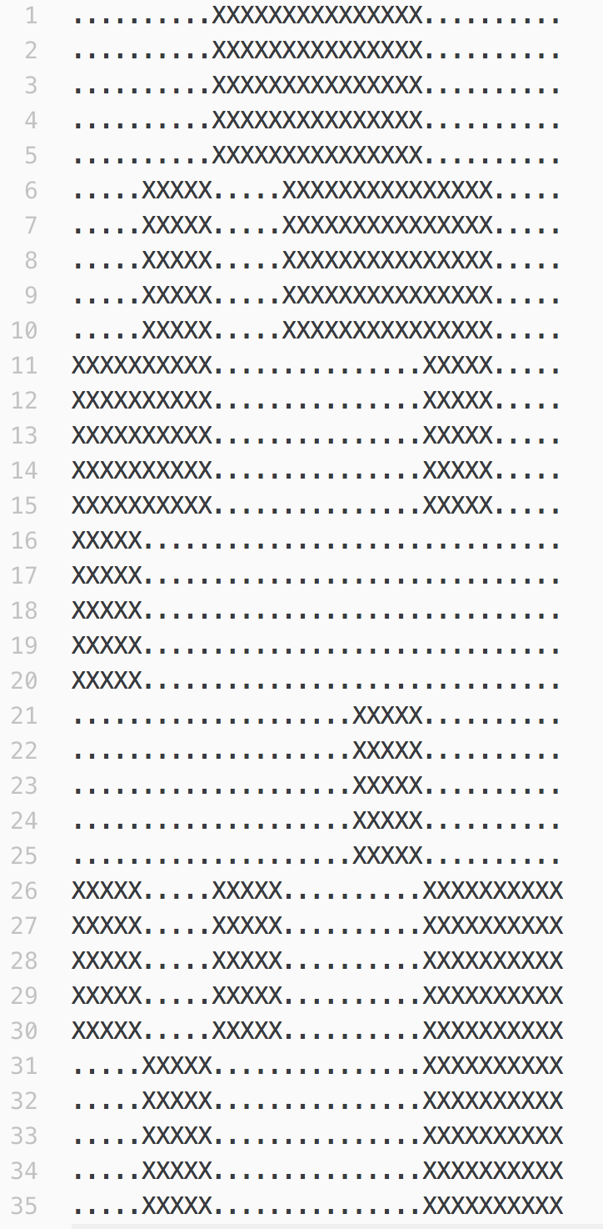
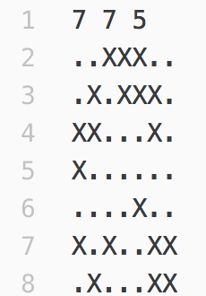
String Operations
Scaled up by 5 times
Dilation with a scale factor of 5

Slide 8
String Operations
Scaled up by 5 times
Dilation with a scale factor of 5

Slide 9
String Operations
The layout of Farmer John's farm is quite peculiar, with a large circular road running around the perimeter of the main field on which his cows graze during the day. Every morning, the cows cross this road on their way towards the field, and every evening they all cross again as they leave the field and return to the barn.
As we know, cows are creatures of habit, and they each cross the road the same way every day. Each cow crosses into the field at a different point from where she crosses out of the field, and all of these crossing points are distinct from each-other. Farmer John owns exactly 26 cows, which he has lazily named A through Z (he is not sure what he will do if he ever acquires a 27th cow...), so there are precisely 52 crossing points around the road. Farmer John records these crossing points concisely by scanning around the circle clockwise, writing down the name of the cow for each crossing point, ultimately forming a string with 52 characters in which each letter of the alphabet appears exactly twice. He does not record which crossing points are entry points and which are exit points.
http://www.usaco.org/index.php?page=viewproblem2&cpid=712
Case analysis: https://docs.google.com/drawings/d/1xvx0A9NdQxq6efeujdvjOwCUWxk95ef2B7o6ArPWzUo/edit
Pseudocode: https://docs.google.com/document/d/1a4iPiyq98az8MxYGB56IbAjKVnn50gfrggjpKzYL46g/edit

Slide 10
String Operations (psuedocode)
char[] letters = {‘A’,’B’,’C’,...’Z’};
count = 0
read in circular barn
for (letter 1 from “A” to “Z”)
for (letter 2 from “A” to “Z”)
if(letter1 <= letter2) continue // Make sure we dont repeat AB and BA
get indices of 1st, 2nd occurance of letter1 from circular barn -> a,b
get indices of 1st, 2nd occurance of letter2 from circular barn -> c,d
check if EITHER a<c<b<d OR c<a<d<b: // Checking for either ABAB or BABA
count++
print(count)

Slide 11
Brute-Force
What’s Brute Force?

Slide 12
Brute-Force
What’s Brute Force?
Brute force means try-all, trial-and-error approach to solving a problem. It might mean trying all possible combinations with little or no strategy.

Slide 13
Brute-Force
What’s Brute Force?
Brute force means try-all, trial-and-error approach to solving a problem. It might mean trying all possible combinations with little or no strategy.
Brute force algorithms are guaranteed correct if implemented properly, but not necessarily efficient! (otherwise we’d have our passwords easily broken, our encrypted data easily decrypted…)

Slide 14
Brute-Force
For many(not all) USACO bronze problems, you can get away with typical brute-force! Think about the bounds on some problems, and how you might reduce this problem…
(Keep in mind, 10⁸ operations is approximately the time limit of ~1-2 seconds on USACO, but it depends on your “constant factor”).

Slide 15
Brute Force
Even if a problem is not intended to be solved with brute force, but you still do so, you can still get away with 40~50% credit, which is better than ZERO!

Slide 16
Brute Force
Even if a problem is not intended to be solved with brute force, but you still do so, you can still get away with 40~50% credit, which is better than ZERO!
(As you go to Silver/Gold/Plat, you will learn new algorithms that will help you move away from Brute force.)

Slide 17
Brute Force
First, try this Brute Force problem - Diamond Collector
http://www.usaco.org/index.php?page=viewproblem2&cpid=639
-Try brute force first, and if you want, two-pointers approach :)
Bovine Genomics:
http://www.usaco.org/index.php?page=viewproblem2&cpid=736

Slide 18
Brute Force
You have probably heard of the game "Rock, Paper, Scissors". The cows like to play a similar game they call "Hoof, Paper, Scissors".
The rules of "Hoof, Paper, Scissors" are simple. Two cows play against each-other. They both count to three and then each simultaneously makes a gesture that represents either a hoof, a piece of paper, or a pair of scissors. Hoof beats scissors (since a hoof can smash a pair of scissors), scissors beats paper (since scissors can cut paper), and paper beats hoof (since the hoof can get a papercut). For example, if the first cow makes a "hoof" gesture and the second a "paper" gesture, then the second cow wins. Of course, it is also possible to tie, if both cows make the same gesture.
Farmer John watches in fascination as two of his cows play a series of N games of "Hoof, Paper, Scissors" (1≤N≤100). Unfortunately, while he can see that the cows are making three distinct types of gestures, he can't tell which one represents "hoof", which one represents "paper" and which one represents "scissors" (to Farmer John's untrained eye, they all seem to be variations on "hoof"...)
Not knowing the meaning of the three gestures, Farmer John assigns them numbers 1, 2, and 3. Perhaps gesture 1 stands for "hoof", or maybe it stands for "paper"; the meaning is not clear to him. Given the gestures made by both cows over all NN games, please help Farmer John determine the maximum possible number of games the first cow could have possibly won, given an appropriate mapping between numbers and their respective gestures.
http://www.usaco.org/index.php?page=viewproblem2&cpid=688

Slide 19
Brute Force
Ideas?

Slide 20
Brute Force
Ideas?
We know that each number (1,2,3) can represent ANY of the three strings - “hoof”, “paper”, “scissors”

Slide 21
Brute Force
Ideas?
We know that each number (1,2,3) can represent ANY of the three strings - “hoof”, “paper”, “scissors”
Make an assumption - Let’s assign 1,2,and 3 to ANY of 6 permutations of (H,P,S)

Slide 22
Brute Force
Ideas?
We know that each number (1,2,3) can represent ANY of the three strings - “hoof”, “paper”, “scissors”
Make an assumption - Let’s assign 1,2,and 3 to ANY of 6 permutations of (H,P,S)
For each assumption, calculate the score (ex: Score given that H=1,P=3,S=2, Score given H=2,P=1,S=3)

Slide 23
Brute Force
Ideas?
We know that each number (1,2,3) can represent ANY of the three strings - “hoof”, “paper”, “scissors”
Make an assumption - Let’s assign 1,2,and 3 to ANY of 6 permutations of (H,P,S)
For each assumption, calculate the score (ex: Score given that H=1,P=3,S=2, Score given H=2,P=1,S=3)
We want the maximum possible score. So pick the largest score over all individual assignments

Slide 24
Solution -Hoof Paper Scissors
Ideas?
We know that each number (1,2,3) can represent ANY of the three strings - “hoof”, “paper”, “scissors”
Make an assumption - Let’s assign 1,2,and 3 to ANY of 6 permutations of (H,P,S)
For each assumption, calculate the score (ex: Score given that H=1,P=3,S=2, Score given H=2,P=1,S=3)
We want the maximum possible score. So pick the largest score over all individual assignments
6 possibilities: 1 > 2 >3 3>1 >2
1 > 3 > 2 3>2>1
2 > 1>3
2> 3> 1

Slide 25
Homework (10/19)
First - finish implementing problems we did in class today.
String Operations:
1)Moocast
2) Why Did the Cow Cross the Road - Pt 2 (optional)
3) Bovine Genomics
Brute-Force:
Diamond Collector
Hoof Paper Scissors
Optional (Strategic Brute-force):
2) Bessie Goes Moo/Bessie Gets Even - challenging! Feel free to ask :)

Slide 26
(OPTIONAL) Strategic Brute-Force: “Bessie Goes Moo”
Note- that for MOST USACO BRONZE problems, you can get away with typical brute-force! Think about the bounds on some problems, and how you might reduce this problem… (Example from USACO 2015 US Open, Silver)
Farmer John and Bessie the cow love to exchange math puzzles in their free time. The last puzzle FJ gave Bessie was quite difficult and she failed to solve it. Now she wants to get even with FJ by giving him a challenging puzzle.
Bessie gives FJ the expression
(B+E+S+S+I+E)(G+O+E+S)(M+O+O)
(B+E+S+S+I+E)(G+O+E+S)(M+O+O), containing the seven variables B,E,S,I,G,O,M (the "O" is a variable, not a zero). For each variable, she gives FJ a list of up to 500 integer values the variable can possibly take. She asks FJ to count the number of different ways he can assign values to the variables so the entire expression evaluates to a multiple of 7.

Slide 27
Strategic Brute-Force: “Bessie Goes Moo”
How can we reduce this problem into simple brute force? What do we really care about?
Farmer John and Bessie the cow love to exchange math puzzles in their free time. The last puzzle FJ gave Bessie was quite difficult and she failed to solve it. Now she wants to get even with FJ by giving him a challenging puzzle.
Bessie gives FJ the expression
(B+E+S+S+I+E)(G+O+E+S)(M+O+O)
(B+E+S+S+I+E)(G+O+E+S)(M+O+O), containing the seven variables B,E,S,I,G,O,M (the "O" is a variable, not a zero). For each variable, she gives FJ a list of up to 500 integer values the variable can possibly take. She asks FJ to count the number of different ways he can assign values to the variables so the entire expression evaluates to a multiple of 7.

Slide 28
Strategic Brute-Force: “Bessie Goes Moo”
Farmer John and Bessie the cow love to exchange math puzzles in their free time. The last puzzle FJ gave Bessie was quite difficult and she failed to solve it. Now she wants to get even with FJ by giving him a challenging puzzle.
Bessie gives FJ the expression
(B+E+S+S+I+E)(G+O+E+S)(M+O+O)
(B+E+S+S+I+E)(G+O+E+S)(M+O+O), containing the seven variables B,E,S,I,G,O,M (the "O" is a variable, not a zero). For each variable, she gives FJ a list of up to 500 integer values the variable can possibly take. She asks FJ to count the number of different ways he can assign values to the variables so the entire expression evaluates to a multiple of 7.
Option 1: Brute force over all 500 integer values B, E, S , I , G, O, M to see if the expression evaluates to a multiple of seven. What is the complexity of this?

Slide 29
Strategic Brute-Force: “Bessie Goes Moo”
Farmer John and Bessie the cow love to exchange math puzzles in their free time. The last puzzle FJ gave Bessie was quite difficult and she failed to solve it. Now she wants to get even with FJ by giving him a challenging puzzle.
Bessie gives FJ the expression
(B+E+S+S+I+E)(G+O+E+S)(M+O+O)
(B+E+S+S+I+E)(G+O+E+S)(M+O+O), containing the seven variables B,E,S,I,G,O,M (the "O" is a variable, not a zero). For each variable, she gives FJ a list of up to 500 integer values the variable can possibly take. She asks FJ to count the number of different ways he can assign values to the variables so the entire expression evaluates to a multiple of 7.
Option 1: Brute force over all 500 integer values B, E, S , I , G, O, M to see if the expression evaluates to a multiple of seven. What is the complexity of this?
We have at most 500 options for each of the letters. Thus, in the worst case, we would be iterating through 500⁷ ≈ 7.8*10¹⁸ values! That’s waay too slow (~10¹⁰ seconds to complete)!!

Slide 30
Strategic Brute-Force: “Bessie Goes Moo”
Farmer John and Bessie the cow love to exchange math puzzles in their free time. The last puzzle FJ gave Bessie was quite difficult and she failed to solve it. Now she wants to get even with FJ by giving him a challenging puzzle.
Bessie gives FJ the expression
(B+E+S+S+I+E)(G+O+E+S)(M+O+O)
(B+E+S+S+I+E)(G+O+E+S)(M+O+O), containing the seven variables B,E,S,I,G,O,M (the "O" is a variable, not a zero). For each variable, she gives FJ a list of up to 500 integer values the variable can possibly take. She asks FJ to count the number of different ways he can assign values to the variables so the entire expression evaluates to a multiple of 7.
Option 2: But, we only care about if the expression is a multiple of 7, in other words, if (B+E+S+S+I+E)(G+O+E+S)(M+O+O) ≡ (0 mod 7). This means, we only care about the individual remainders/residues of B,E,S,I,G,O,M (mod 7).

Slide 31
Strategic Brute-Force: “Bessie Goes Moo”
Farmer John and Bessie the cow love to exchange math puzzles in their free time. The last puzzle FJ gave Bessie was quite difficult and she failed to solve it. Now she wants to get even with FJ by giving him a challenging puzzle.
Bessie gives FJ the expression
(B+E+S+S+I+E)(G+O+E+S)(M+O+O)
(B+E+S+S+I+E)(G+O+E+S)(M+O+O), containing the seven variables B,E,S,I,G,O,M (the "O" is a variable, not a zero). For each variable, she gives FJ a list of up to 500 integer values the variable can possibly take. She asks FJ to count the number of different ways he can assign values to the variables so the entire expression evaluates to a multiple of 7.
But, we only care about if the expression is a multiple of 7, in other words, if (B+E+S+S+I+E)(G+O+E+S)(M+O+O) ≡ (0 mod 7). This means, we only care about the individual remainders/residues of B,E,S,I,G,O,M (mod 7). What’s the complexity now?

Slide 32
Strategic Brute-Force: “Bessie Goes Moo”
Farmer John and Bessie the cow love to exchange math puzzles in their free time. The last puzzle FJ gave Bessie was quite difficult and she failed to solve it. Now she wants to get even with FJ by giving him a challenging puzzle.
Bessie gives FJ the expression
(B+E+S+S+I+E)(G+O+E+S)(M+O+O)
(B+E+S+S+I+E)(G+O+E+S)(M+O+O), containing the seven variables B,E,S,I,G,O,M (the "O" is a variable, not a zero). For each variable, she gives FJ a list of up to 500 integer values the variable can possibly take. She asks FJ to count the number of different ways he can assign values to the variables so the entire expression evaluates to a multiple of 7.
But, we only care about if the expression is a multiple of 7, in other words, if (B+E+S+S+I+E)(G+O+E+S)(M+O+O) ≡ (0 mod 7). This means, we only care about the individual residues/remainders of B,E,S,I,G,O,M (mod 7). What’s the complexity now? Since there are only 7 possible values for each letter, we only need 7⁷ = 823,543 << 10⁸ operations!

Slide 33
Strategic Brute-Force: “Bessie Goes Moo”
Given that (B+E+S+S+I+E)(G+O+E+S)(M+O+O) ≡ 0 (mod 7), how will we count the total number of possibilities for a given arrangement of remainders for B,E,S,I,G,O,M
(for example; the arrangement B ≡ 1, E ≡ 2 , S ≡ 3, I ≡ 3, G≡ 2, O ≡ 2, M ≡ 2 (all mod 7))?

Slide 34
Strategic Brute-Force: “Bessie Goes Moo”
Given that (B+E+S+S+I+E)(G+O+E+S)(M+O+O) ≡ 0 (mod 7), how will we count the total number of possibilities for a given arrangement of remainders for B,E,S,I,G,O,M
(for example; the arrangement B ≡ 1, E ≡ 2 , S ≡ 3, I ≡ 3, G≡ 2, O ≡ 2, M ≡ 2 (all mod 7))?
We can keep track of the number of B’s that are ≡ 1 (mod 7), number of E’s ≡ 2 (mod 7), and so forth, using a 2D array num[letter][remainder]. We simply multiply the number of each letter with its corresponding remainder (num[‘B’][1] * num[‘E’][2] * num[‘S’][3] *....) to get the number of combinations of B’s, E’s, S’s, ..M’s with the given remainder arrangement that are divisible by 7.

Slide 35
Strategic Brute-Force: “Bessie Goes Moo”
Given that (B+E+S+S+I+E)(G+O+E+S)(M+O+O) ≡ 0 (mod 7), how will we count the total number of possibilities for a given arrangement of remainders for B,E,S,I,G,O,M
(for example; the arrangement B ≡ 1, E ≡ 2 , S ≡ 3, I ≡ 3, G≡ 2, O ≡ 2, M ≡ 2 (all mod 7))?
We can keep track of the number of B’s that are ≡ 1 (mod 7), number of E’s ≡ 2 (mod 7), and so forth, using a 2D array num[letter][remainder]. We simply multiply the number of each letter with its corresponding remainder (num[‘B’][1] * num[‘E’][2] * num[‘S’][3] *....) to get the number of combinations of B’s, E’s, S’s, ..M’s with the given remainder arrangement that are divisible by 7.
Finally, we add up the number of combinations corresponding to a certain valid arrangement of remainders over all possible valid remainder arrangements.

